Slide 1


XML - Entity References
Some characters have a special meaning in XML.
If you place a character like "<" inside an XML element, it will generate an error because the parser interprets it as the start of a new element.
This will generate an XML error
To avoid this error, replace the "<" character with an entity reference:

Slide 2
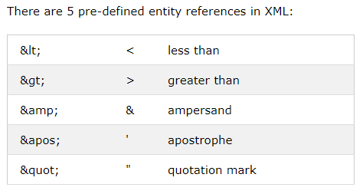
XML - Entity References

